Slide 1

Forecasting Gold Prices in Sri Lanka using ANN and KNN Approaches
E.J.K.P. Nandani
nandani@maths.ruh.ac.lk
Department of Mathematics,
Faculty of Science,
University of Ruhuna
March 03, 2021

Slide 2
Outline
Introduction
Research Rationale
Materials and Methods
Results & Discussion
Conclusion
References

Slide 3
Introduction
Forecasting is the process of estimating the relevant events of the future, based on the analysis of their past and present behavior.
Forecasting techniques:
Each method has its properties, accuracies, and costs that must be considered when choosing a specific method. However, no method can be suggested as universally applicable.
Statistical methods
Regression
Time series methods
Moving Average
Exponential smoothing
ARIMA
Bayesian methods
Machine learning methods
Artificial Neural Network
Support Vector Machine
K-Nearest Neighbor
etc.

Slide 4
Rationale of the research
Literature Review
“Forecasting Sri Lankan Gold Prices using Time Series Analysis “
Pitigalaarachchi P.A.A., Jayasundara D.D.M., Chandrasekara N.V., International journal of sciences: basic and applied research (IJSBAR) 27(3):247-260, 2016.
“Prediction of Daily Gold Prices in Sri Lanka: A Comparison of Time Series and Artificial Neural Network Models.”
Shashikala, M. A. G., Chandrasekara, N.V., And jayasundara, D. D. M., International research symposium on pure and applied sciences, faculty of science, university of kelaniya,sri lanka.(2017)
Objectives:
Forecasting next-day Gold prices in sri lanka using
K-nearest neighbors (KNN) algorithm.
Artificial neural network (ANN) model based on
Back-propagation Learning algorithm.
Compare the accuracy of ANN and KNN forecasting models

Slide 5
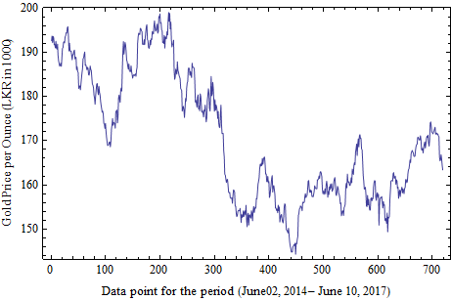
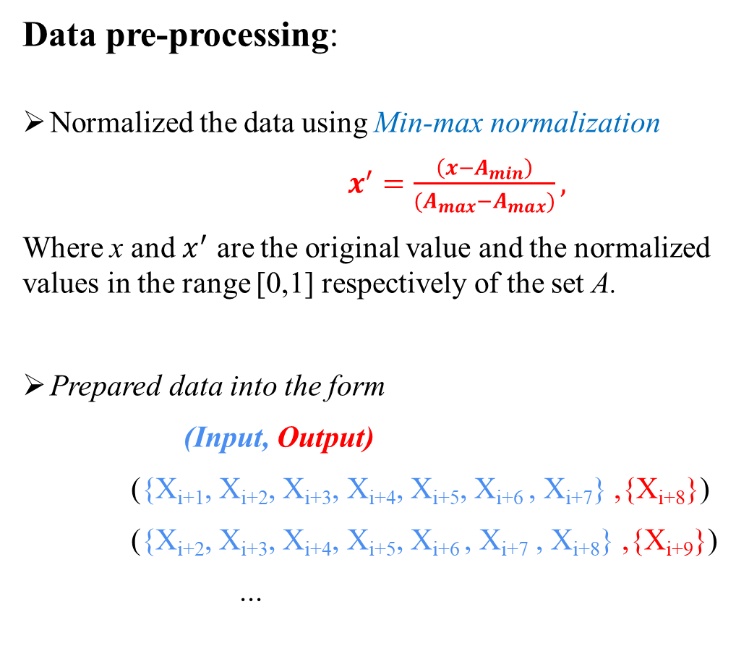
Materials and Methods
Data pre-processing:
Normalized the data using Min-max normalization
$x^{′}=\frac{\left(x−A_{min}\right)}{{(A}_{max}−A_{max})},$
Where x and $x^{′}$ are the original value and the normalized values in the range [0,1] respectively of the set A.
Prepared data into the form
(Input, Output)
({x_{i+1}, x_{i+2}, x_{i+3}, x_{i+4}, x_{i+5}, x_{i+6} , x_{i+7}} ,{x_{i+8}})
({x_{i+2}, x_{i+3}, x_{i+4}, x_{i+5}, x_{i+6} , x_{i+7} , x_{i+8}} ,{x_{i+9}})
...

Slide 6
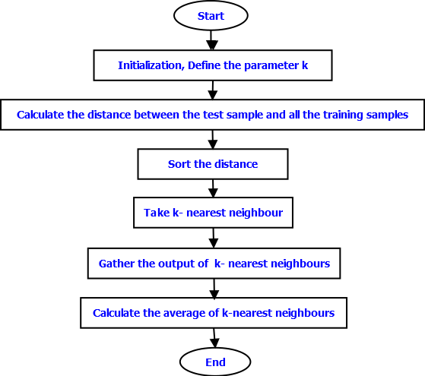
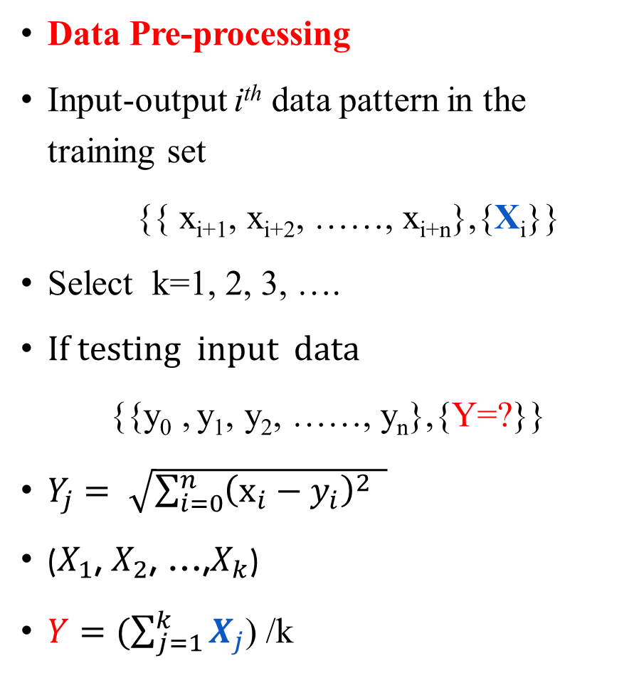
KNN Algorithm
Data Pre-processing
Input-output i^{th} data pattern in the training set
{{ x_{i+1}, x_{i+2}, ……, x_{i+n}},{X_{i}}}
Select k=1, 2, 3, ….
If testing input data
{{y₀ , y₁, y₂, ……, y_{n}},{Y=?}}
$Y_{j}= \sqrt{\sum_{i=0}^{n}{{\left(x_{i}−y_{i}\right)}^{2} }}$
($X_{1}$, $X_{2}$, …,$X_{k}$)
$Y=(\sum_{j=1}^{k}{X_{j}}$) /k

Slide 7
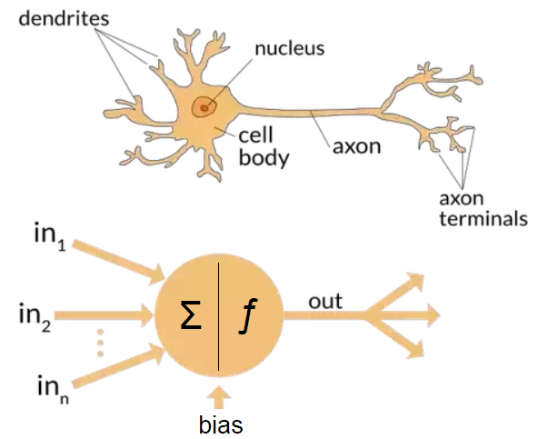
ANN model

Slide 8
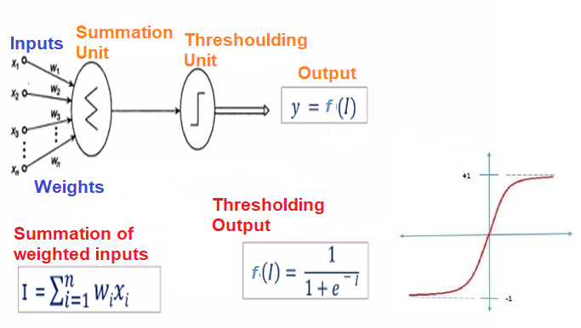
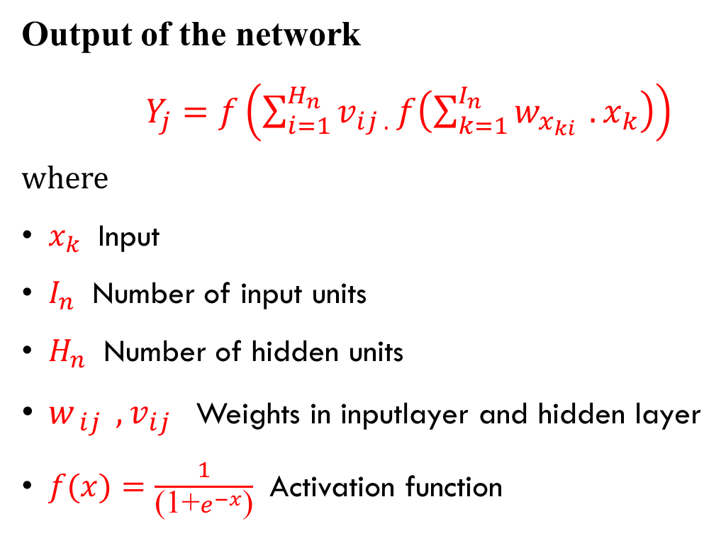
Calculation of ANN model
Output of the network
$Y_{j}=f\left(\sum_{i=1}^{H_{n}}{v_{ij .}}f\left(\sum_{k=1}^{I_{n}}{w_{x_{ki} }.}x_{k}\right)\right)$
where
$x_{k}$ Input
$I_{n}$ Number of input units
$H_{n}$ Number of hidden units
$w_{ ij } ,v_{ij }$ Weights in inputlayer and hidden layer
$f(x)=\frac{1}{\text{(1+}e^{−x}\text{)}}$ Activation function

Slide 9
Results
Forecasting next-day Gold price by KNN algorithm
Forecasting next-day Gold price by ANN model
Comparing accuracy between KNN& ANN models

Slide 10
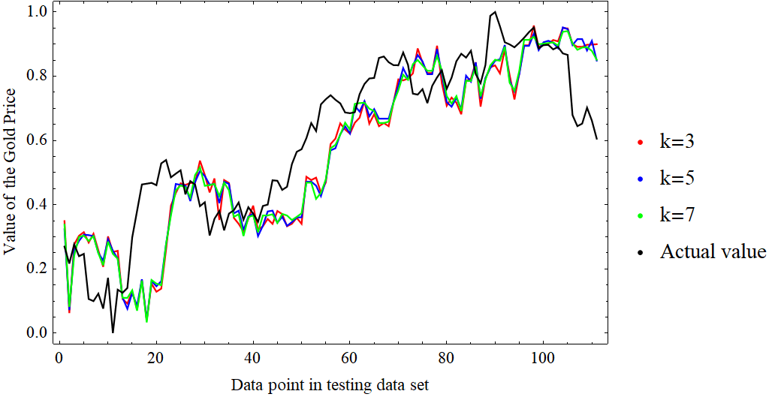
Forecasting next-day Gold price by KNN algorithm

Slide 11
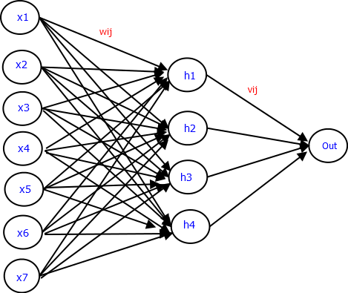
Forecasting next-day Gold price by ANN model
Network Architecture
Parameters | Values
# input units | 7
# hidden units | 4
# output units | 1
Initial weights | Randomly selected (-1,1)
Learning rate | 0.8
# Iterations | 6000

Slide 12
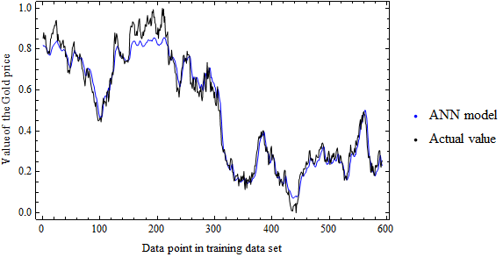
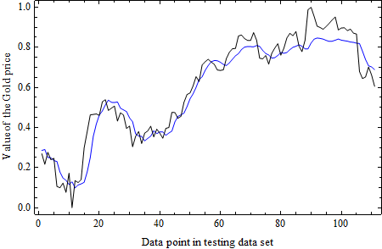
Forecasting next-day Gold price by ANN model
Network output for the Testing set
Network output for the Training set

Slide 13
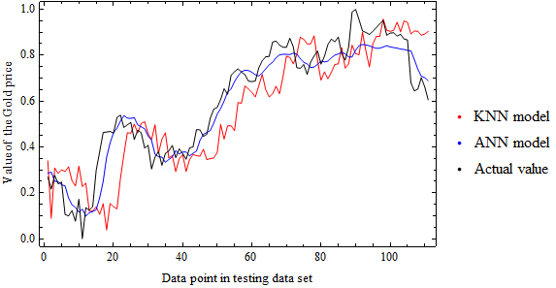
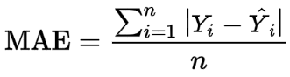
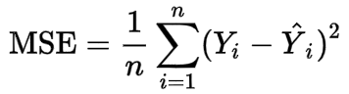
Comparing accuracy between KNN& ANN models
Error Measurements
Model | MSE | MAE
ANN | 0.004780 | 0.054833
KNN | 0.021825 | 0.118098

Slide 14
Conclusion
The accuracy measures (MSE and MAE) in this study indicate that the ANN approach performed better forecasting accuracy than the KNN approach for the gold price in sri lanka.
Although there are some deviations between predicted values in the KNN approach and actual values, they have very similar fluctuations as shown in the figure. So, the KNN and ANN approached will be able to forecast the time series data such as gold price, share price, etc.

Slide 15
References
Igiri chinwe peace, anyama oscar uzoma, silas abbasiama ıta and sam lini, (2015), ınternational journal of engineering research & technology (IJERT), vol. 4, (3)
Qi yu, yoan miche, antii sorjamaa, alberto guillen, amaury lendasse and eric severin, (2010), “ OP-KNN: method and applications”, advance in artificial neural systems, vol. 2010.
Mahfuzah mustafa, mohd nasir taib, zunairah hj. Murat and norizam sulaiman, journal of computer science & computational mathematics, volume 2, ıssue 4, april 2012.
Nitin malik, national conference on “ unearthing technological developments & their transfer for serving masses”, glaıtm, mathura, ındia 17-18 april 2005.
Pitigalaarachchi p.A.A., Jayasundara D.D.M., Chandrasekara N.V., International journal of sciences: basic and applied research (IJSBAR) 27(3): 247-260, 2016.
Shashikala, m. A. G., Chandrasekara, N.V., And jayasundara, D. D. M., International research symposium on pure and applied sciences, faculty of science, university of kelaniya,sri lanka, 2017.

Slide 16
Thank You

